Slide 1
THE WAR MINI PROJECT!!
Application of inheritance in Python
Data Science and Machine Learning Bootcamp
July 25, 2025

Slide 2
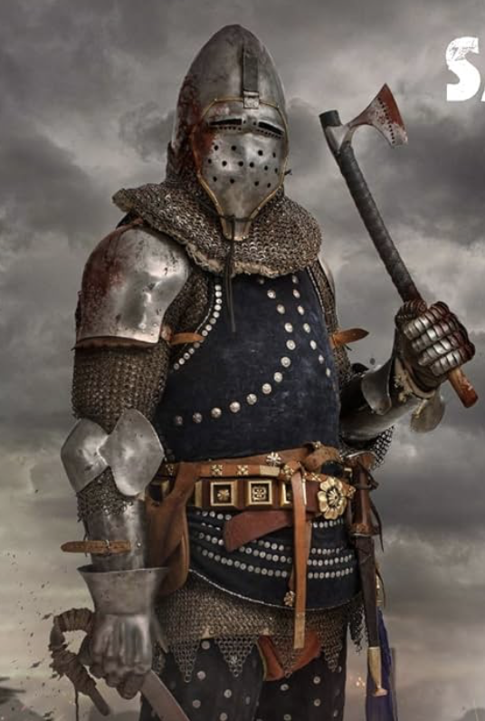

Introduction:
The Vikings and the Saxons are at War!

Slide 3
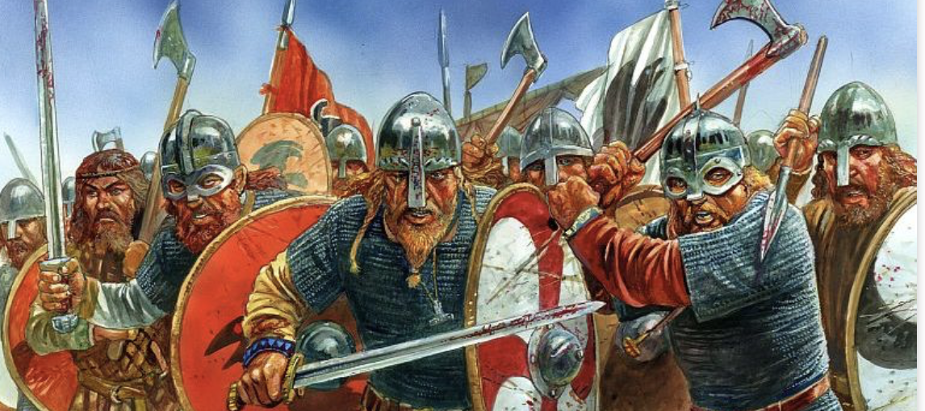

Let´s code the war!!

Slide 4

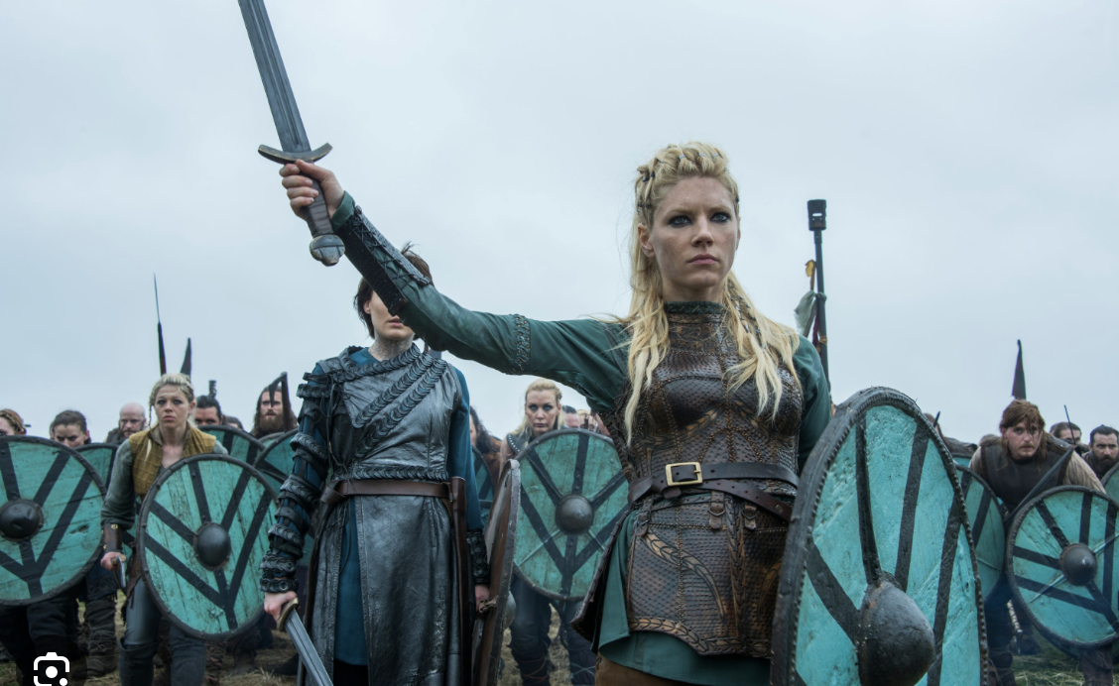
Definition of Child classes:

Slide 5
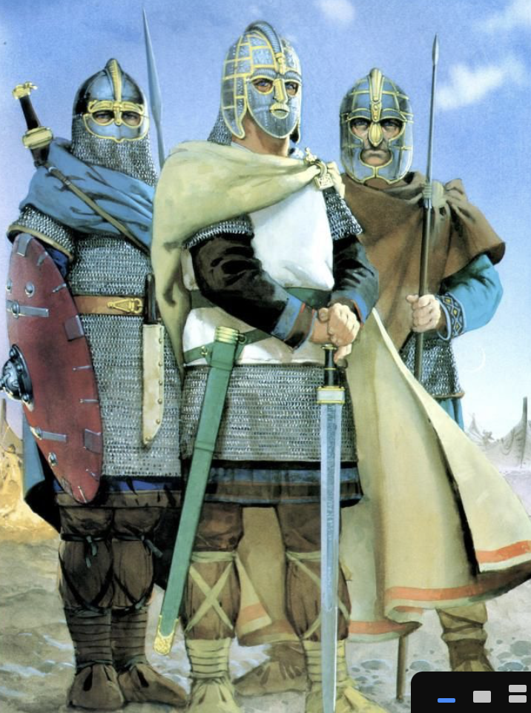

Definition of Child classes:

Slide 6
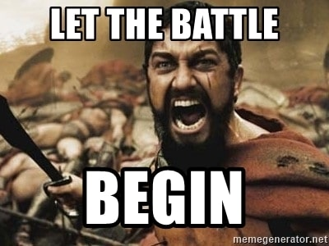
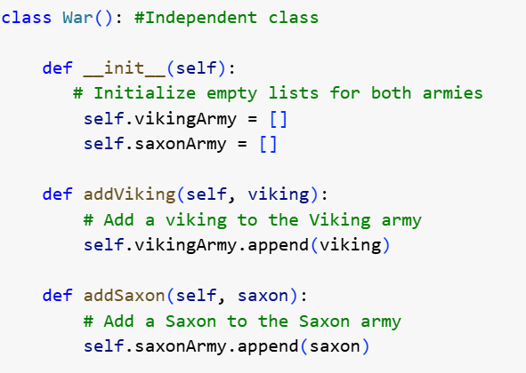
Class War

Slide 7
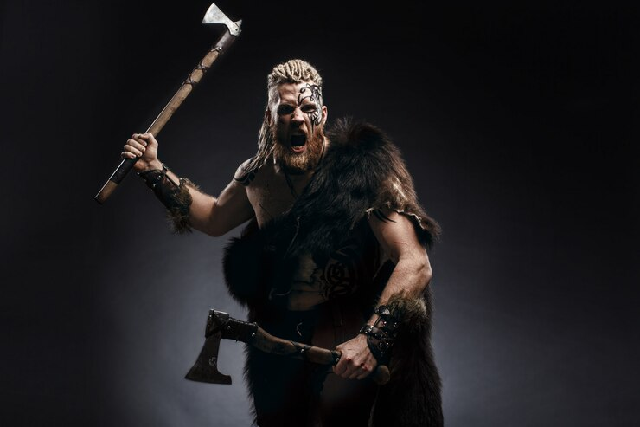
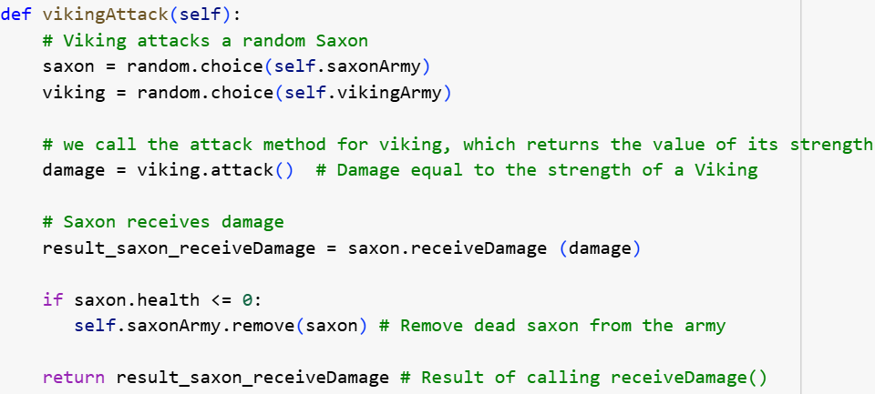
Class War

Slide 8
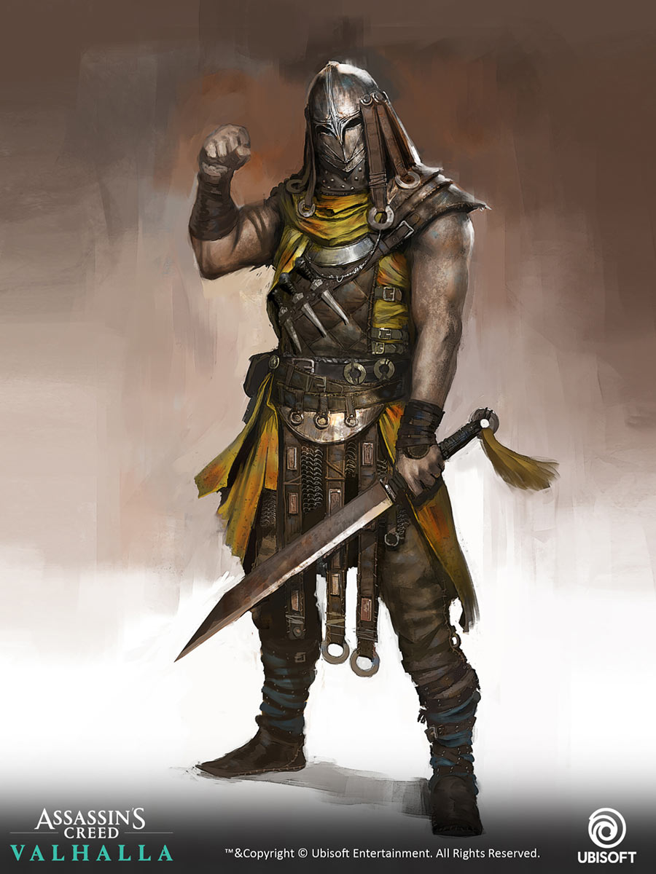
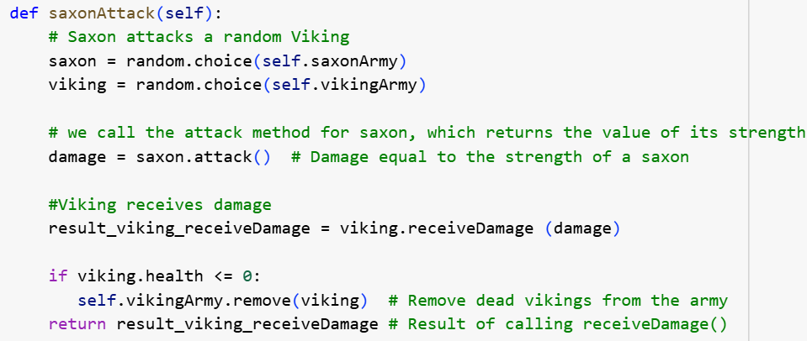
Class War

Slide 9
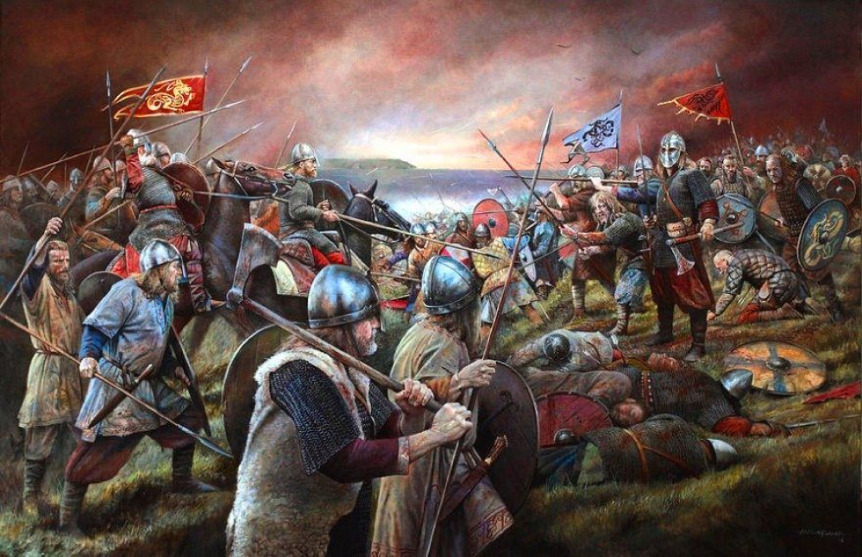

Class War

Slide 10
WAR CODING BY:
Raíssa Franco
Zahory Vasquez

